Slide 1



AN AUTOMATED TASK UTILIZING RPA FOR SALES
SUPPORT AND MARKETING
2023

Slide 2
Madhur 19BEC1057
Sushant Kumar 19BEC1078
Team Introduction
Rishali Rishu 19BEC1108
Kartik Bhardwaj 19BEC1049
Mentor: Dr. Harmeet Singh
ELECTRONICS AND COMMUNICATION ENGINEERING UIE, CU

Slide 3
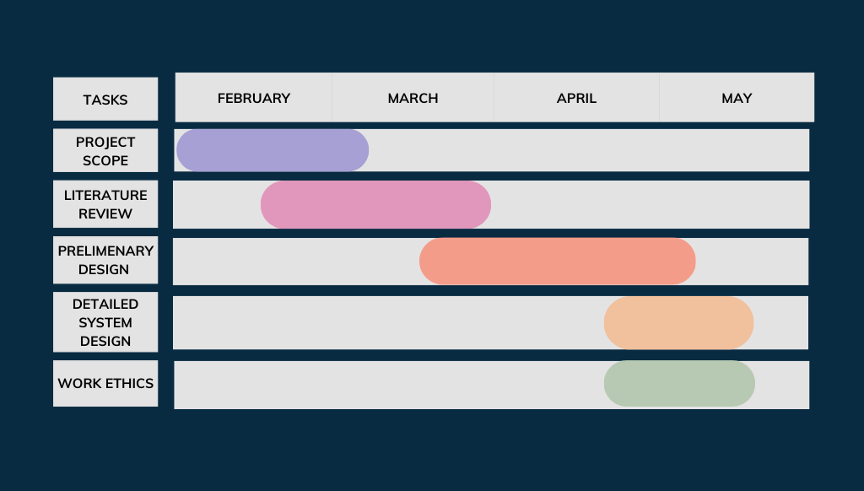
Gantt chart

Slide 4



Problem Statement
The manual processing of purchase orders wastes time and is ineffective. Each new order had to be physically verified by human agents, who also had to check the system for any new orders.
The process from the time a customer makes an order to when it is dispatched and the revenue is received and logged into the system
Manual processing in the entire system makes for a significant loss in revenue and valuable time

Slide 5


Objective
The project's primary goal is to design and create an automated task utilizing RPA for sales support and marketing.
To automate sales and marketing.
To ensure that the proposed solution is correct and efficient for sales support and marketing.

Slide 6
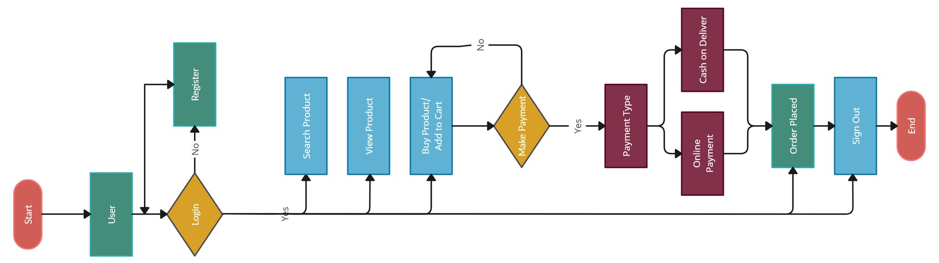






Methodology

Slide 7
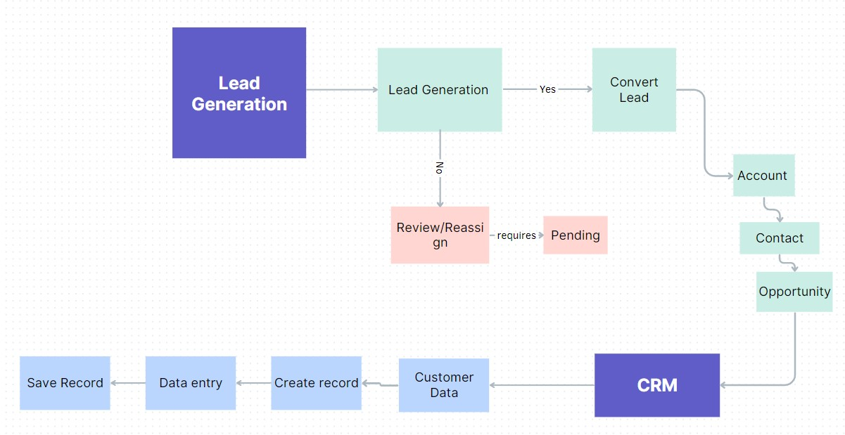
Proposed Solution

Slide 8
Platform
Robotic process automation (RPA) is a software technology that makes it easy to build, deploy, and manage software robots that emulate humans actions interacting with digital systems and software

Slide 9
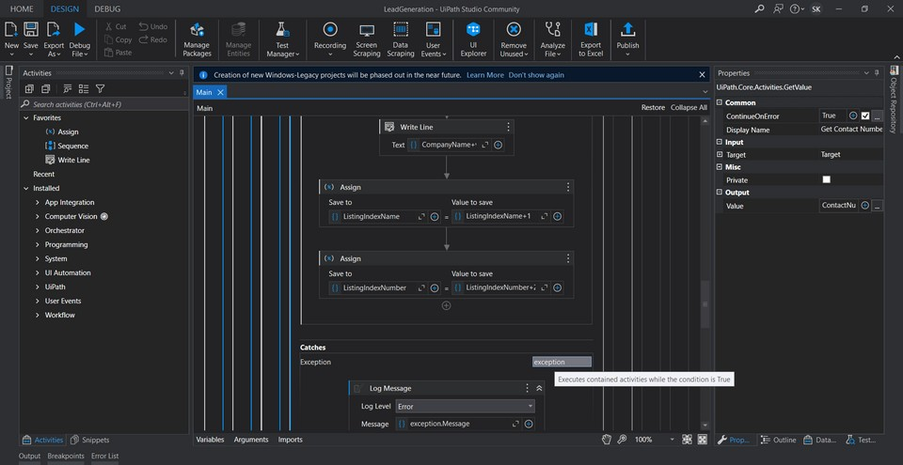
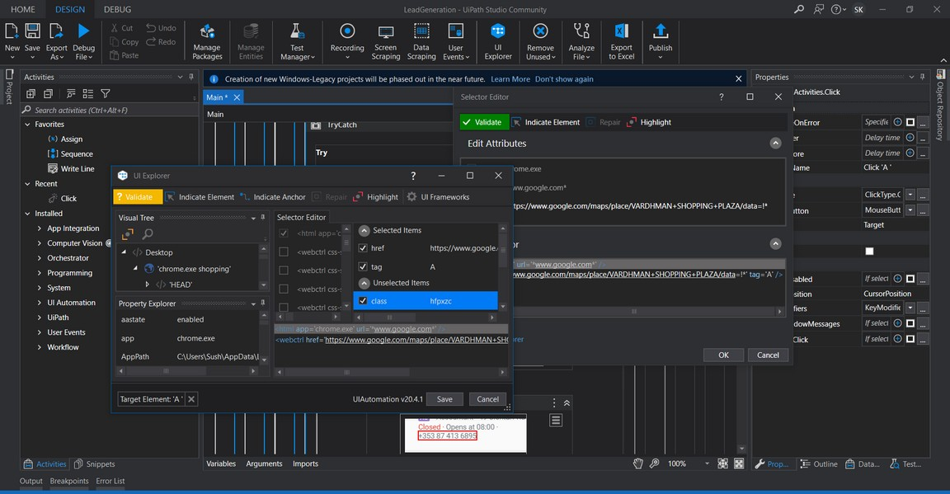
Pictures from the Project

Slide 10
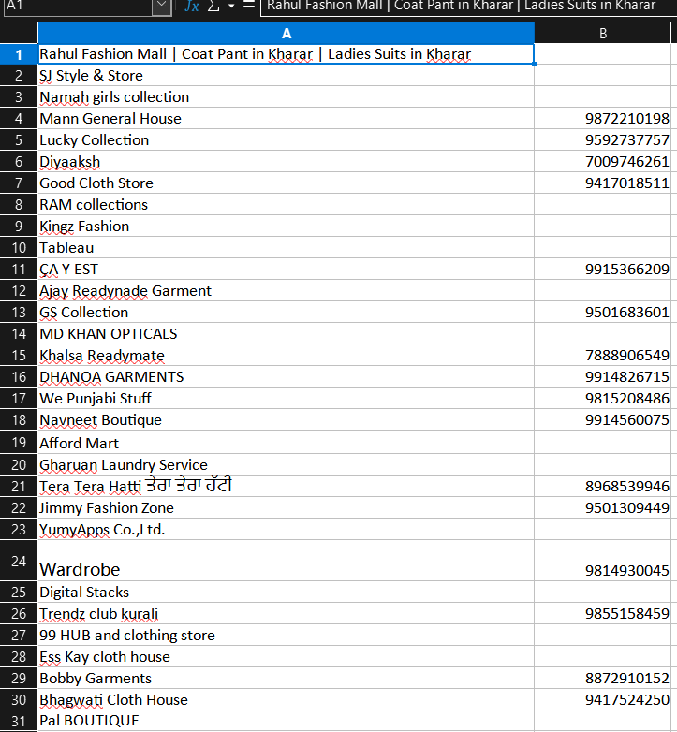
Results

Slide 11
Conclusion
RPA is a dynamic and rapidly evolving area, with significant potential to transform how organizations approach these critical business functions.
While there are challenges and limitations to be addressed, the benefits of RPA are clear. With ongoing research and development, this technology is likely to become an increasingly important tool for organizations seeking to stay ahead of the competition in today's fast-paced business environment. with this project, we want to prove how easy it is to automate tasks that directly help grow income and businesses.

Slide 12

THANK YOU

